Slide 1


Slide 2
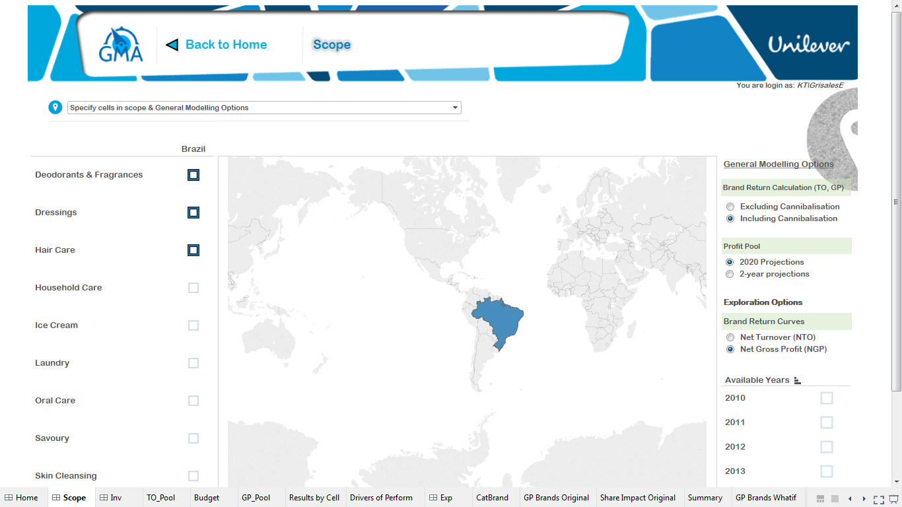
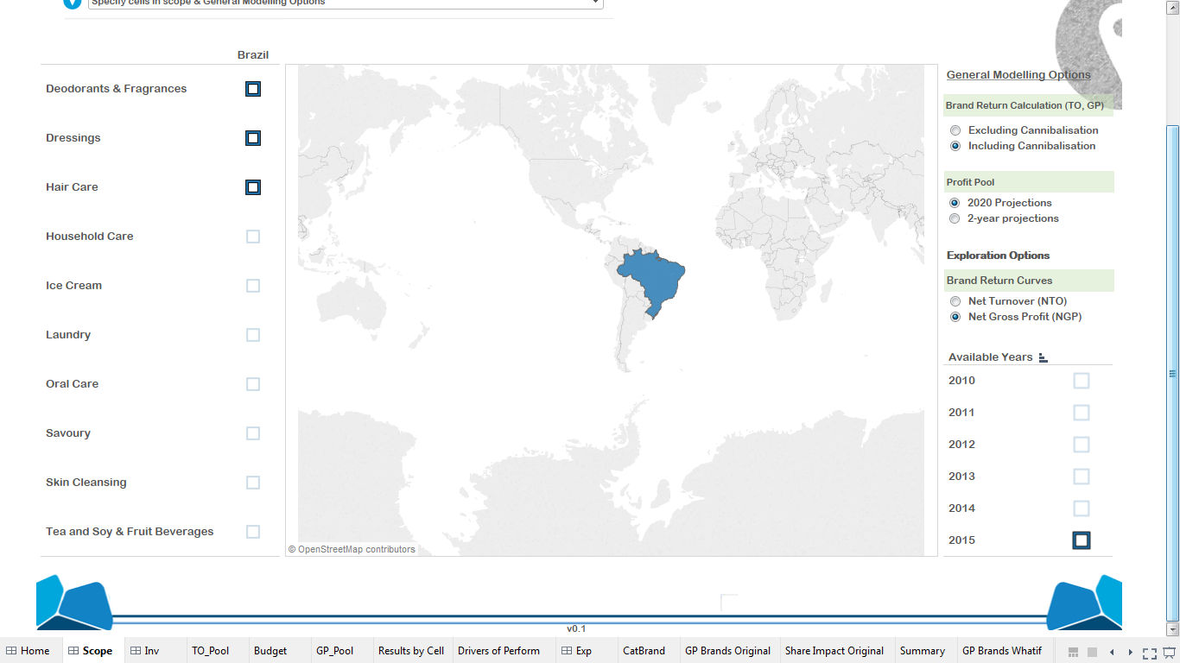
Keep the menu same as first page, with lit up words
Still need to work on a better sub-menu
Kill the brand return curves
Modeling Year, only the years we have parameters for: 2015, 2016
+ Available Budget (Quarters/Months)

Slide 3
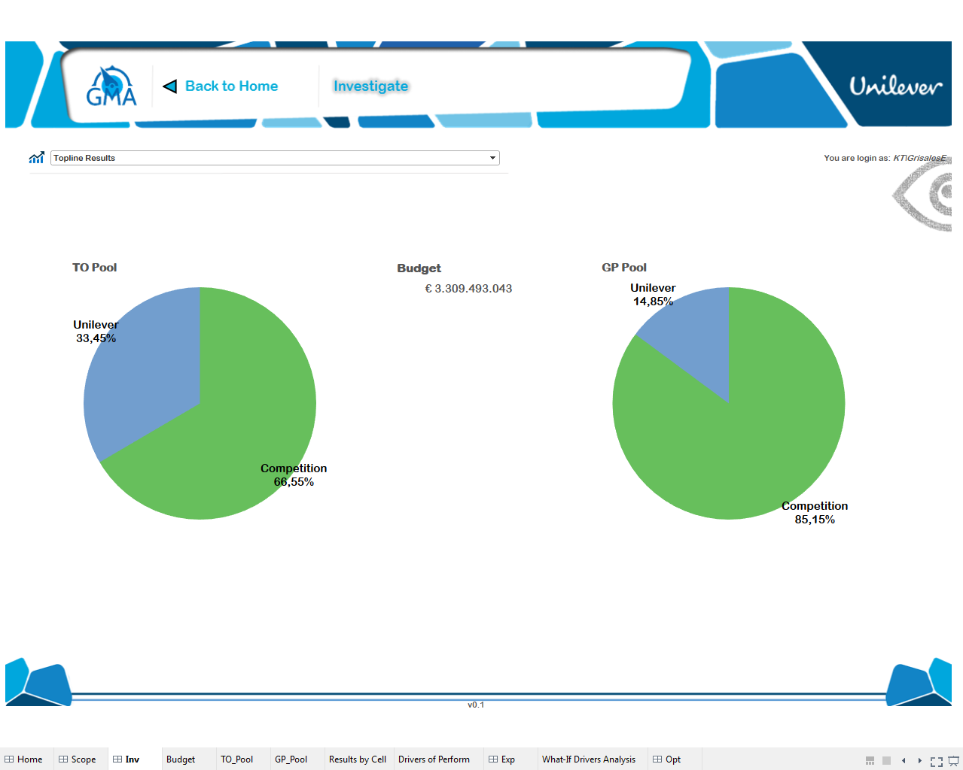
Le modifique los colores, tamaño de los pies y la lista desplegable le puse color

Slide 4
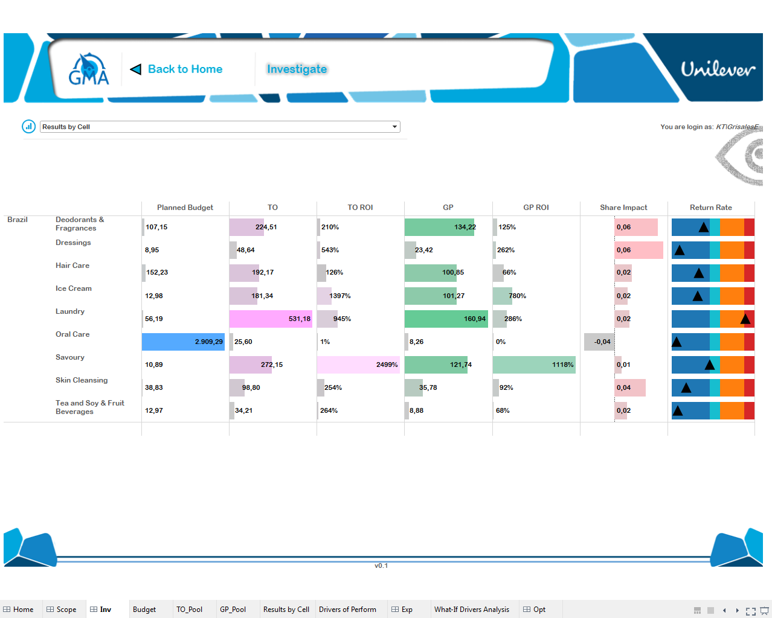
Really need the sub-menu with hyperlinks
Add units, American convention, one decimal
1 Color for Budget, 2 color for TO and TO ROI, 1 color for GP and GP ROI, 1 color for share impact
In percentage points, and with +/- sign
Green-Yellow-Red
ya
Solo lo pude cambiar para Share impact
Ni idea
ya
Adicional ajuste el tamaño de “ajuste automatico” de cada una de las barras

Slide 5
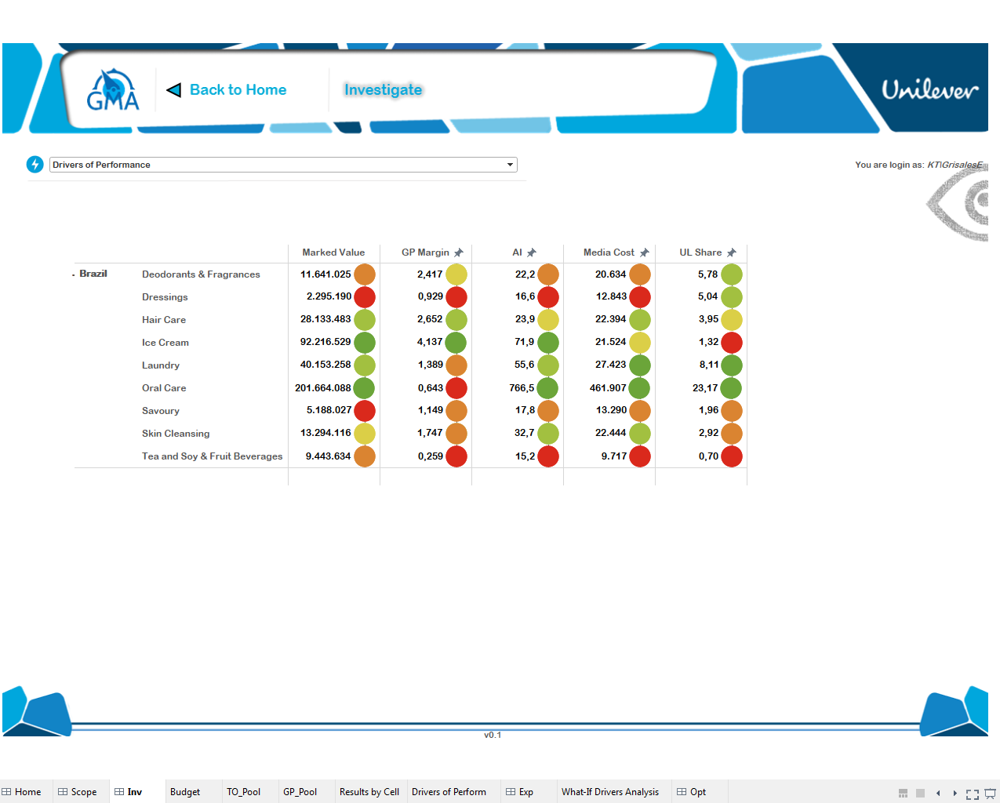
Make zoom in symbol always visible
Add units, market value million euros, GP margin in %, AI no decimal point, Media cost should be named “GRP cost” in euros even, Unilever share = % of market value
Ajuste el tamaño de “ajuste automatico” de cada una de las barras

Slide 6
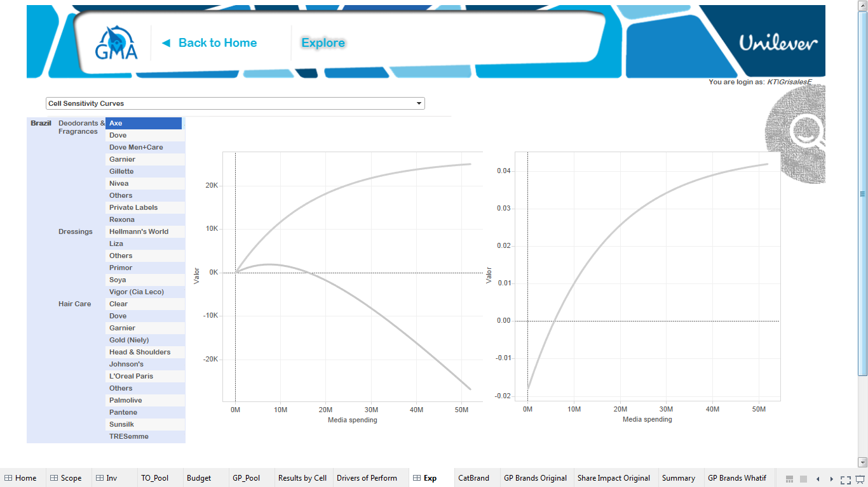
Add option to select curves to show: TO, GP, Net TO, Net GP
Return Curves
Share Impact (+-)
Net TO
Hover to show values
Add category curves with stable brand share as discussed
PBO

Slide 7
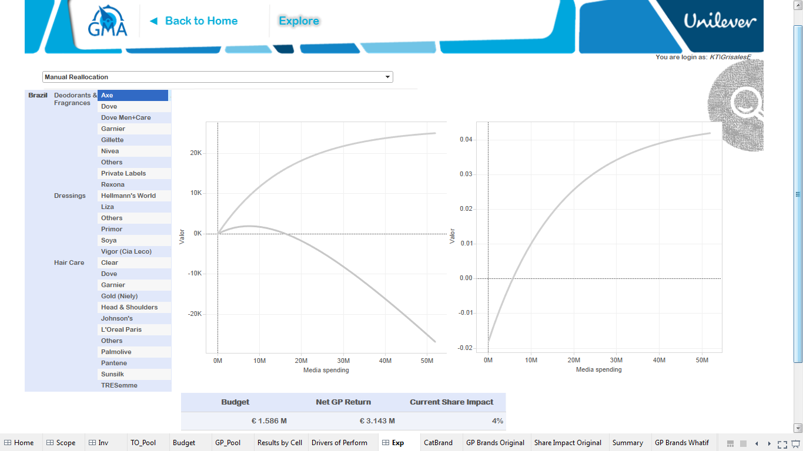
Return Curves
Share Impact (+-)
Follow the brief and continue

Slide 8
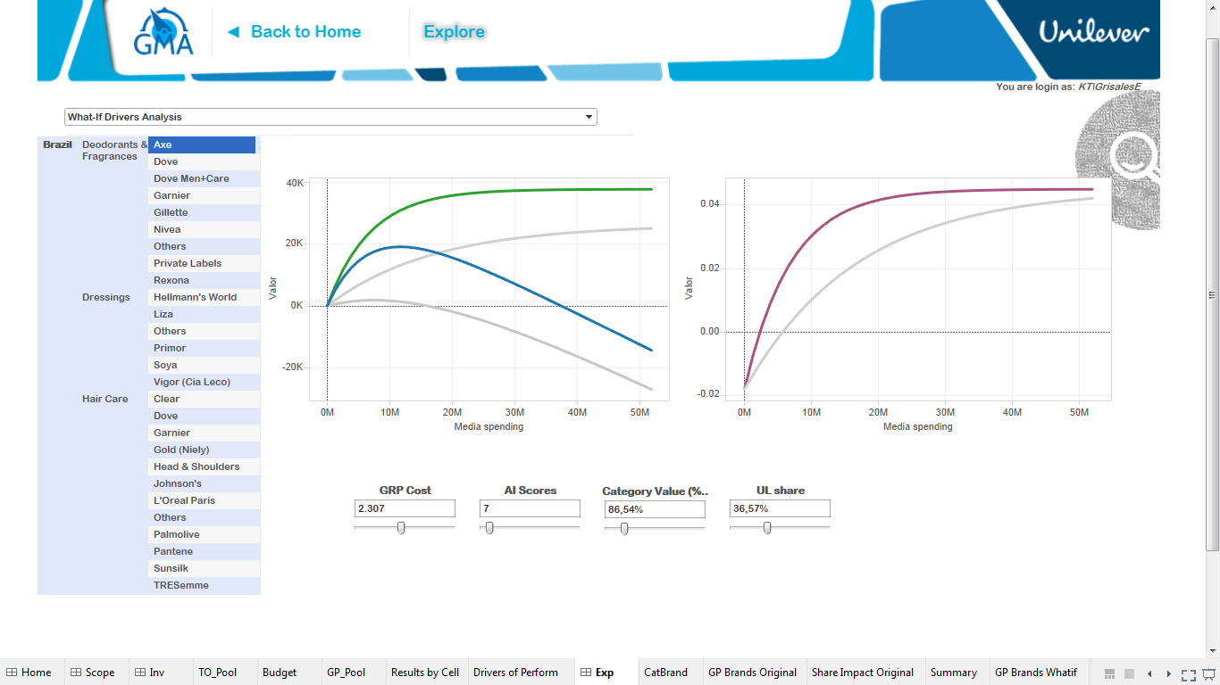
Add option to select curves to show: TO, GP, Net TO, Net GP
Return Curves
Share Impact (+-)
Hypothetical curve should be same color but dotted line
Each curve should have unique color
Axes should not move with and confuse the curve movement
Add category curves with stable brand share as discussed
Show the default point
Show the average point
Have a reset button

Slide 9
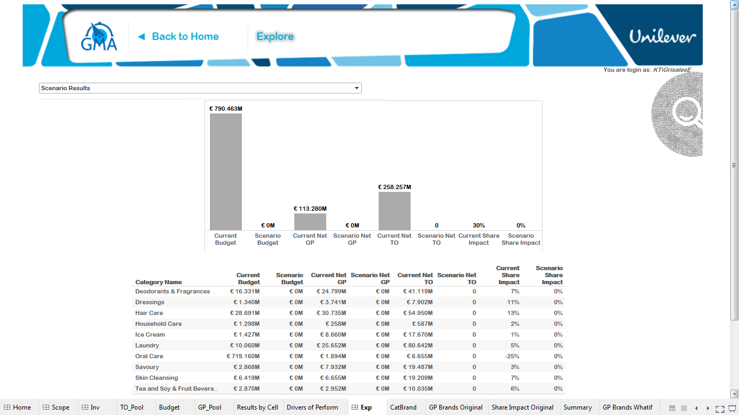
Scenario: Base should be current budget
Same colors as in first page
Keep working on this

Slide 10
